Slide 1





My lean & mean NORWEGIAN MARIE CURIE IEF
Theodossis A. Theodossiou

Slide 2





First, my Biosketch by locations:
2013- IKF Strålingbiologi
2001-6 Postdoc UCL (PDT)
Marie-Curie
IEF
1995 PhD Physics U Bham
1996-7 Military service
2006-2013 NCSR “Demokritos”
1991-2 Scholarship SSF GR
1998-2001 Post-doc NTUA (biophysics)
1990 BSc Physics NKUA

Slide 3
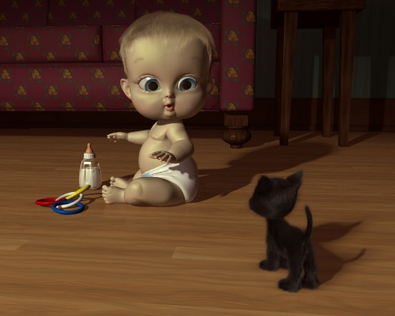
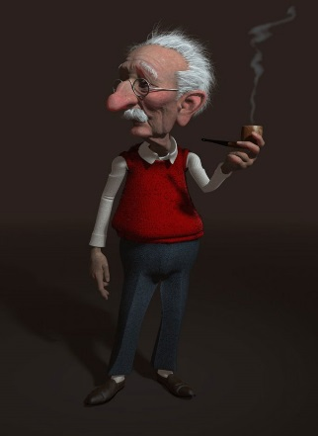


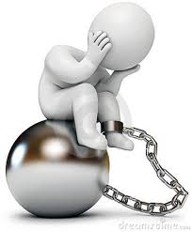


When to pursue a Marie Curie Fellowship:
No age limitations as it is lifelong training schemes. (Obviously not 2 years before retirement!)
Do you seek an early independence, leadership and a highflying career?
Do you feel your current position is a deadlock and you need to do something to boost your career?
Do you feel you want to meet other people and see how things are done in other places?
Do you feel you need a complete career reboot?
Have circumstances kept you out of action for some time and now you want back in?
Do you have an interesting project in mind and want to implement it in a specific lab?

Slide 4


(Why?) Advantages of a Marie Curie Fellowship:
People oriented; especially IEF or Outgoing, are personal: create your own project in a field of your choice and an environment of your choice.
Clear guidelines, easy to write
Good remuneration package including mobility bonus
A great starting point for writing EU applications
Prestigious and significant for career
Quick evaluation (< 1 year from deadline to start in my case 8 months)
Marie Curie Fellows have a significantly increased chance of receiving an ERC grant!

Slide 5
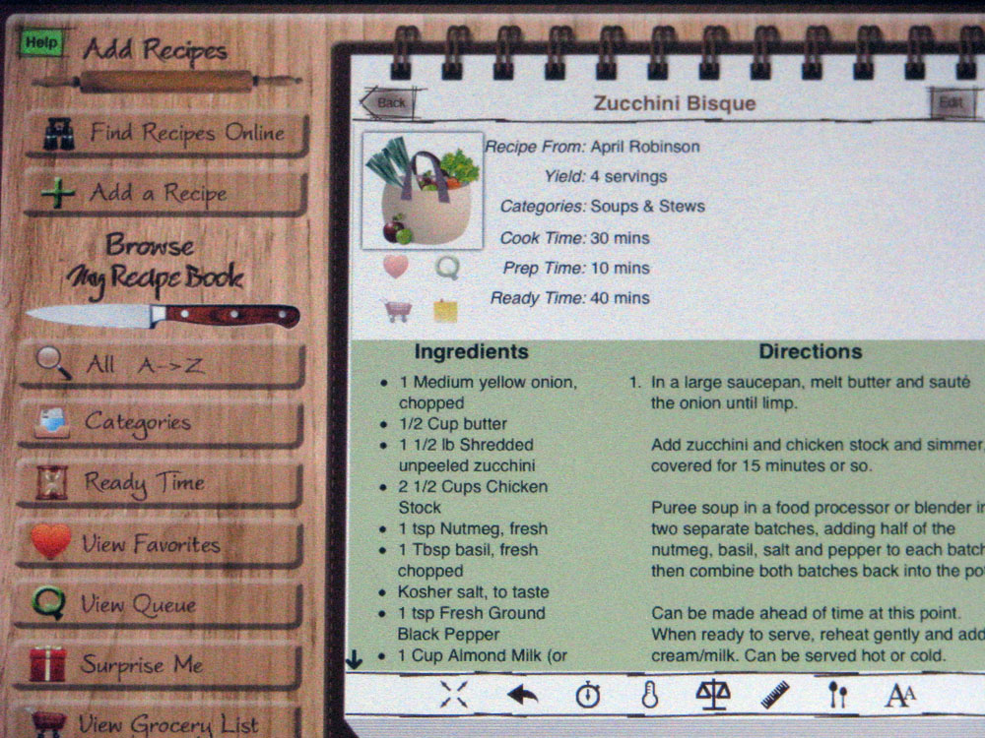

Marie Curie
1 dash of adventure
1 cup of PR with 1 pinch
networking
4 portions of ambition
3 Tbsp strategic writing

Slide 6




(What to do) The Recipe:
Mobility – MSC likes you to move! Go new places, meet new people, get new Knowledge! DON’T BE AFRAID TO MOVE… IT LOOKS GOOD ON YOUR CV.
Find a host: a) High profile – prominent B) good match for the project. LOOK AT WHAT YOU HAVE DESIGNED AND FIND THE “GURU” IN THE FIELD. Communicate early! -1 pinch of PR and networking-
Design a project together with your host! A) ambitious B) Good fit with your CV C) giving you clear cut transferable skills that will take you further. IT IS ALL ABOUT (LIFELONG) TRAINING. - I am 46!
Understand what they expect from you and write it down the way they want: WHY? Why you? / Why now?/ Why there?/ Why that project/ and why with that person. WHAT? What will you learn?/ What will come out ?/ What afterwards? (How does EU capitalize?)

Slide 7
EXAMPLE- OUR PROJECT:
“HYPERTAM” MARIE CURIE IEF 2012
It was built on the combination of two separate concepts we had recently published…

Slide 8
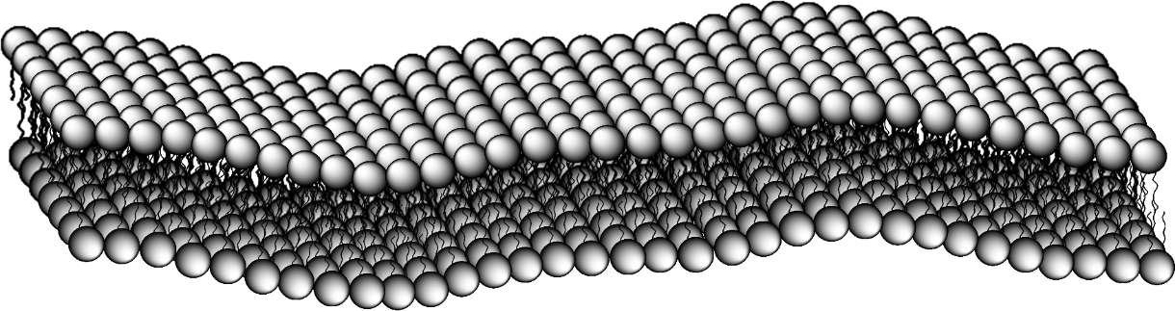
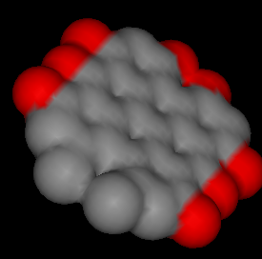
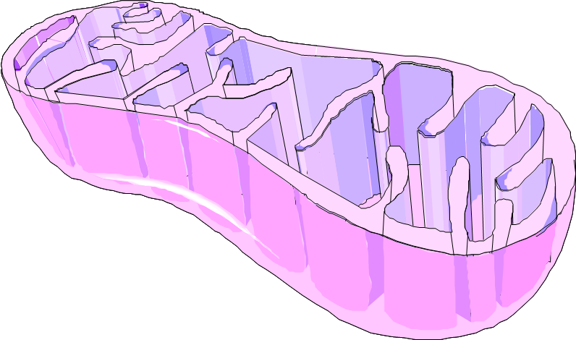
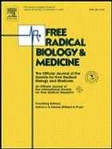
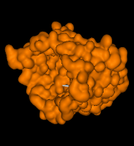
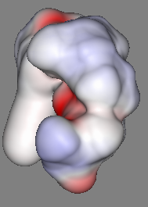
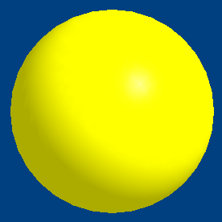
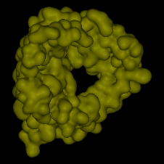
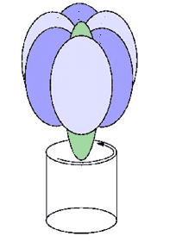
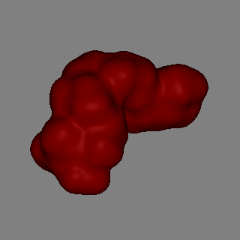
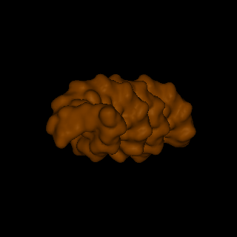
Plasma
membrane
Cell Membrane
Free Radical Biology Medicine,
2008, 45: 1581–1590
hν
Aconitase
Hypericin
Succinoxidase
TCA cycle
Complex III
Ca⁺² Uniporter
F₀F₁ ATPase
Reverse Mode
H⁺
H⁺
ATP (Depletion)
Mitochondrion
H⁺
H⁺
H⁺
H⁺
H⁺
H⁺
H⁺
pH
Decrease
Ca²⁺ from
calcium stores
Hexokinase
ADP + Pi
Unbound Hexokinase
Cytosol
Mol. Pharmaceutics
2009, 6: 1775–1789

Slide 9
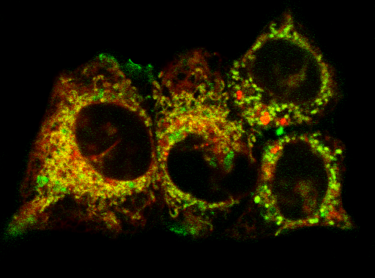
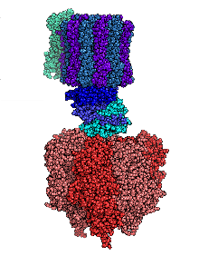
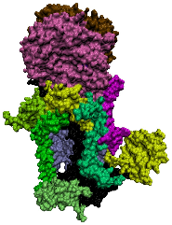
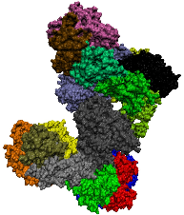
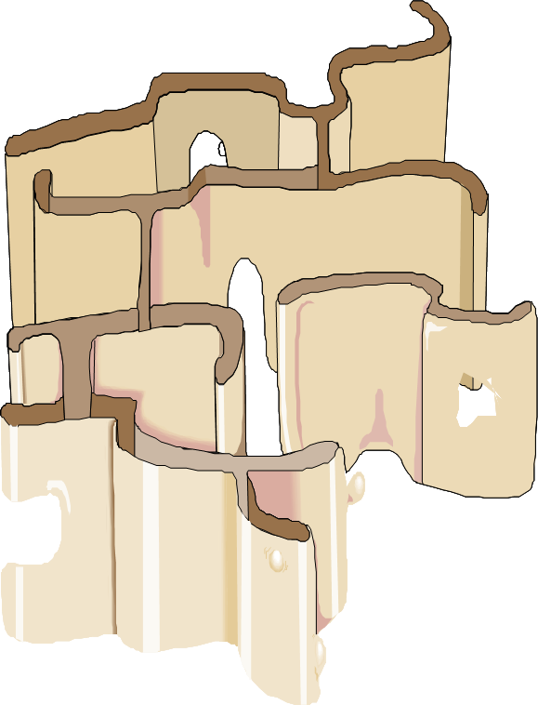
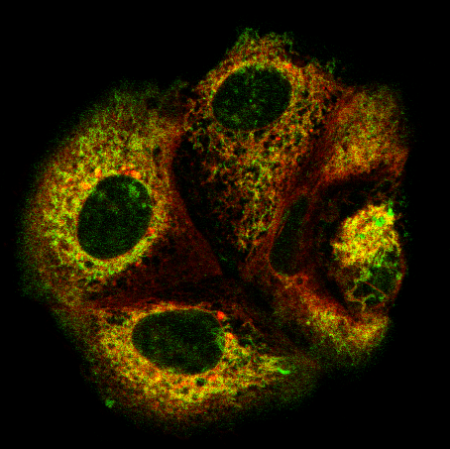
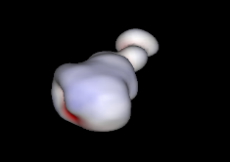



Two concepts very
compatible with my
CV, also very novel and
we could back them
up with publications.
TAMOXIFEN
?
III
Mitochondria
I
Photochem. Photobiol.
2012, 88: 1016–1022
Myxothiazol
Endoplasmic Reticulum

Slide 10
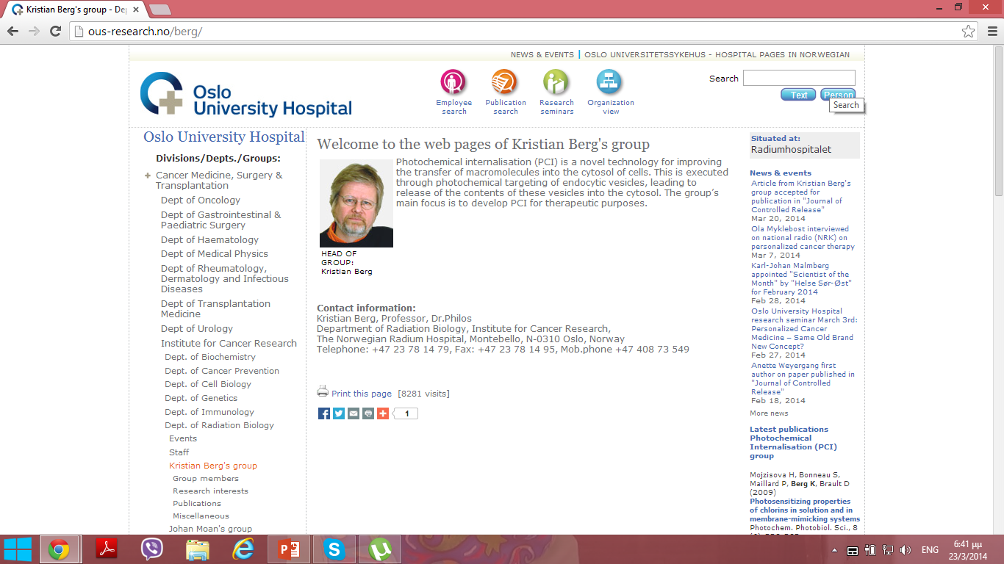
Kristian: Internationally acknowledged and very prominent in
PDT and also the father of Photochemical internalization.

Slide 11

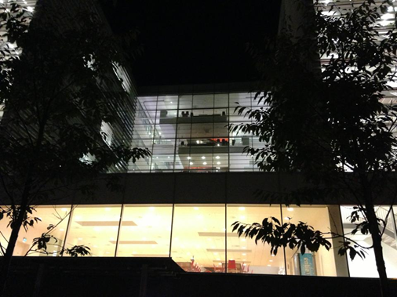
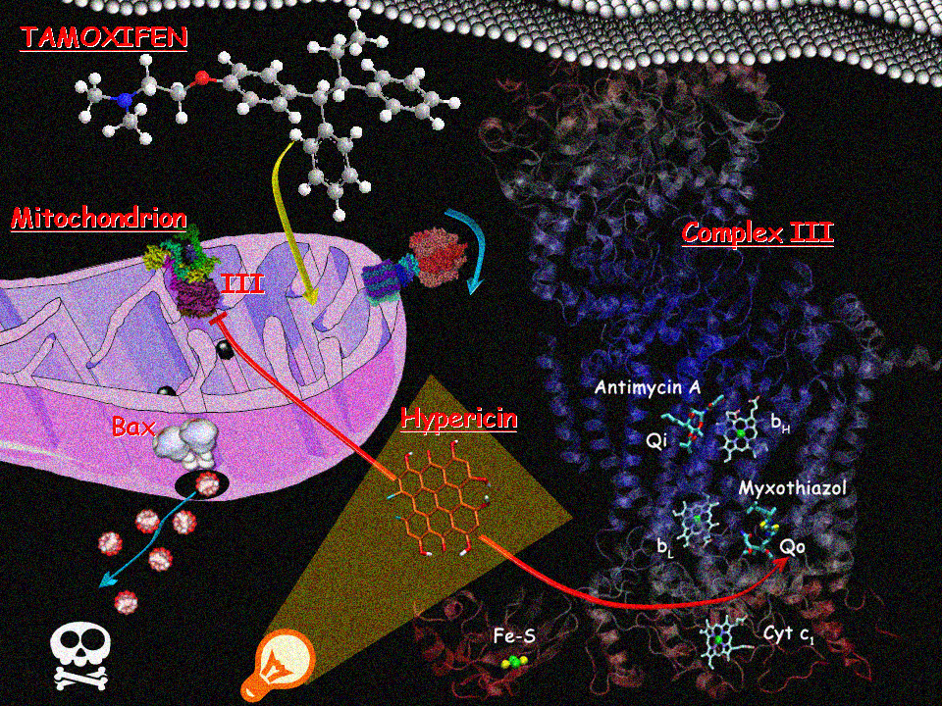
So Kristian and I embarked into writing a proposal (summer 2012) called “HYPERTAM” for a Marie Curie IEF fellowship which was well received and got a final score of 94% (December 2012). So I am here since June 2013. The application aims to a) explore the effect of TAM and myxo on MCF7s and b) also explore the potential synergy of TAM and hypericin through complex III inhibition.

Slide 12
Some closing tips and remarks:
Try to get hold of past successful Marie Curie projects to use as guides rather than templates.
Give a memorable “catchy” acronym that describes as close as possible your project e.g. HYPERTAM = Hypericin+Tamoxifen
Use at least a picture or a drawing to illustrate your proposal. “An image is worth 1000 words” and also breaks the reviewers boredom.
The Marie Curie proposal was an eye opener for me: The strategy of writing an EU application. After this now we have submitted a proposal in health (Horizon 2020), and are planning to carry on with further applications.
➔Here we have a team of people who are brilliant and expert in supporting such efforts. I know because of their help with my IEF but also we have recently been liaising in writing our EU Health (Horizon 2020) application and they are really the bee’s knees!
TUSEN TAKK og Tvi Tvi !!!!

